Slide 1


What is Full Stack Development and Why it is important ?

Slide 2

Topics to be covered
What is web development?
Importance of web development
Frontend vs Backend vs Fullstack

Slide 3

What is web development ?

Slide 4

Importance of web development

Slide 5
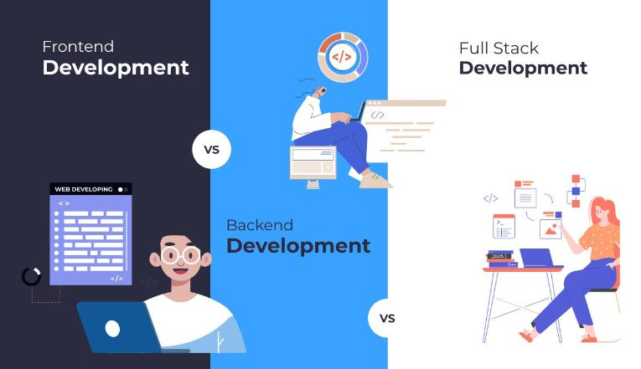
Frontend vs Backend vs Fullstack

Slide 6
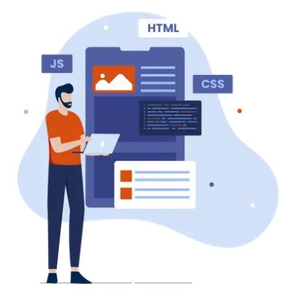
What is Frontend Development ?

Slide 7
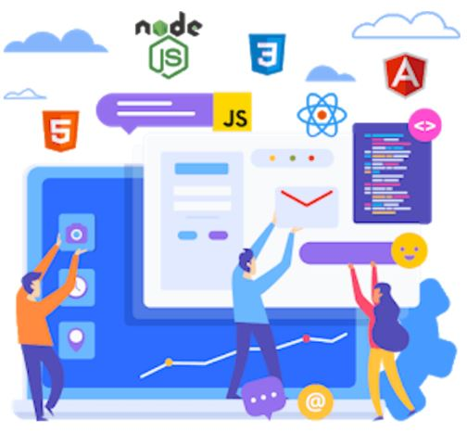
Popular frontend technologies

Slide 8
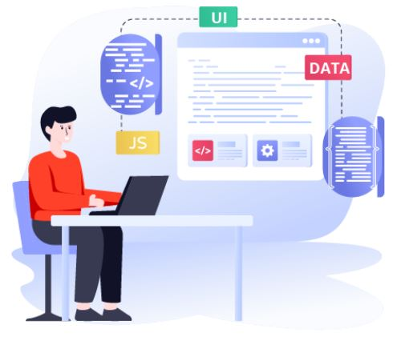
What is Backend Development ?

Slide 9
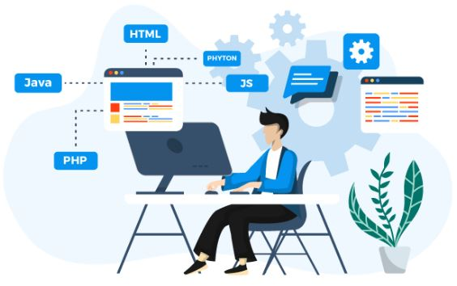
Popular Backend technologies

Slide 10
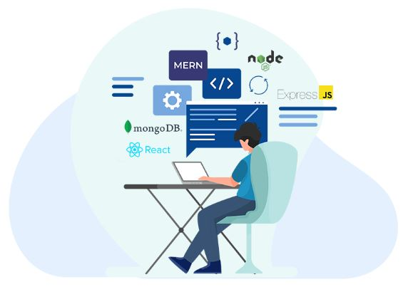
What is Full Stack Development ?

Slide 11
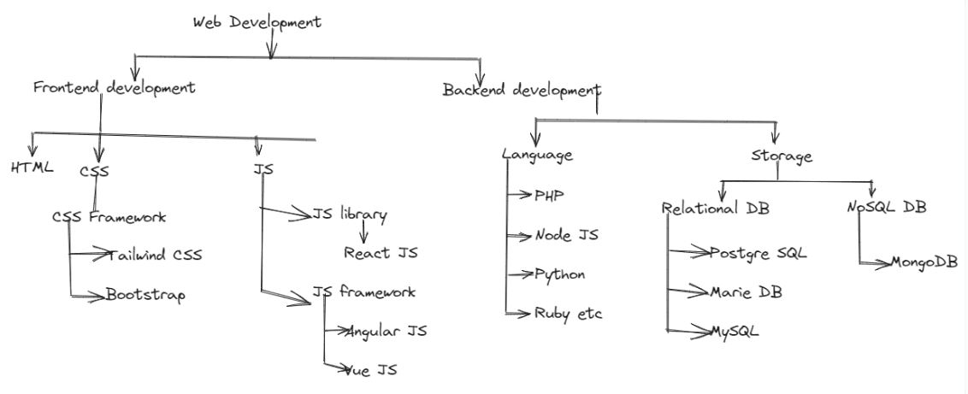
Full Stack Development

Slide 12

THANK YOU

